Slide 1
Modularised
Script
Script
Modules

Slide 2
Script
Module 1
Module 1
Module 2
Module 2
Module 3
Module 3
Non-Modularised Script
#Section 1
Create functions
#Section 2
Read data
Data manipulation
Final data table
#Section 3
Create charts
01_Create functions
Individual scripts
02_Read data
03_Data manipulation
04_Final data table
05_Create charts
Modularised Script
Header code
source(“file_01” )
source(“file_02” )
child = “file_03”
source(“file_04” )
child = “file_05”

Slide 3
Unmodularised Script
Scripts
Modularised Script
Load packages
Load packages
Create functions
Functions
Read in functions
Read in data
Read in final data
Read in data
Data manipulation
Output final data for charts
Data manipulation
Create final data for charts
Charts
Charts
Read in charts
Data manipulation
Create final data for charts

Slide 4
Non-Modularised Script
Individual Scripts
Modularised Script
Load packages
Load packages
# Section 1
# Section 1
# Section 1
e.g. create functions
e.g. create functions
Read in functions
# Section 2
# Section 2
# Section 2
e.g. read in data
e.g. read in data
Read in final data
e.g. data manipulation
e.g. data manipulation
# Section 3
e.g. final data table
e.g. final data table
Read in charts
# Section 3
# Section 3
e.g. create charts
e.g. create charts
Data manipulation
Create final data for charts

Slide 5
Non-Modularised Script
Individual Scripts
Modularised Script
Load packages
Load packages
# Section 1
# Section 1
# Section 1
e.g. create functions
e.g. create functions
Read in functions
# Section 2
# Section 2
# Section 2
e.g. read in data
e.g. read in data
Read in final data
e.g. data manipulation
e.g. data manipulation
# Section 3
e.g. final data table
e.g. final data table
Read in charts
# Section 3
# Section 3
e.g. create charts
e.g. create charts
Data manipulation
Create final data for charts

Slide 6
Non-Modularised Script
Individual Scripts
Modularised Script
Load packages
Load packages
# Section 1
# Section 1
# Section 1
e.g. create functions
e.g. create functions
Read in functions
# Section 2
# Section 2
# Section 2
e.g. read in data
e.g. read in data
Read in final data
e.g. data manipulation
e.g. data manipulation
# Section 3
e.g. final data table
e.g. final data table
Read in charts
# Section 3
# Section 3
e.g. create charts
e.g. create charts
Data manipulation
Create final data for charts

Slide 7
Script
Modules
Modularised Script
Non-Modularised Script
Individual Scripts
Modularised Script
Load packages
Modularised Script
Load packages
# Section 1
# Section 1
# Section 1
Read in functions
Load packages
e.g. create functions
e.g. create functions
# Section 1
# Section 2
# Section 2
Read in functions
# Section 2
Read in data
e.g. read in data
e.g. read in data
# Section 2
e.g. data manipulation
e.g. data manipulation
# Section 3
Read in final data
e.g. final data table
e.g. final data table
Read in charts
# Section 3
Read in charts
# Section 3
# Section 3
e.g. create charts
e.g. create charts

Slide 8
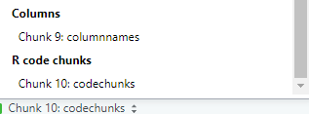
Create final data for charts

Slide 9
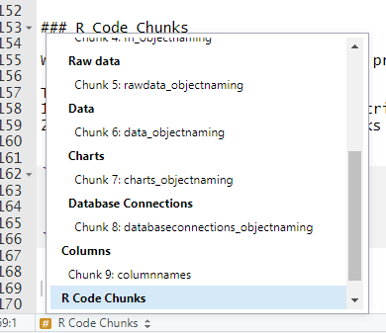
Example Code Chunk Names
Example Use of Scroll

Slide 11
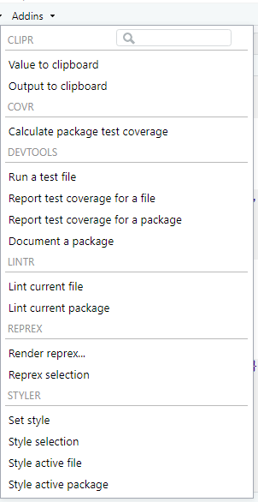

Slide 13
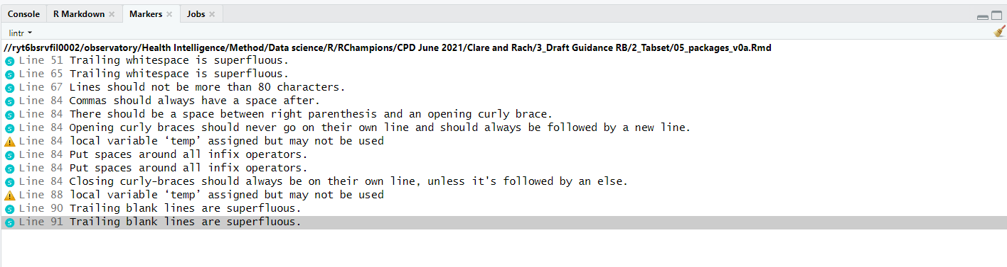

Slide 14
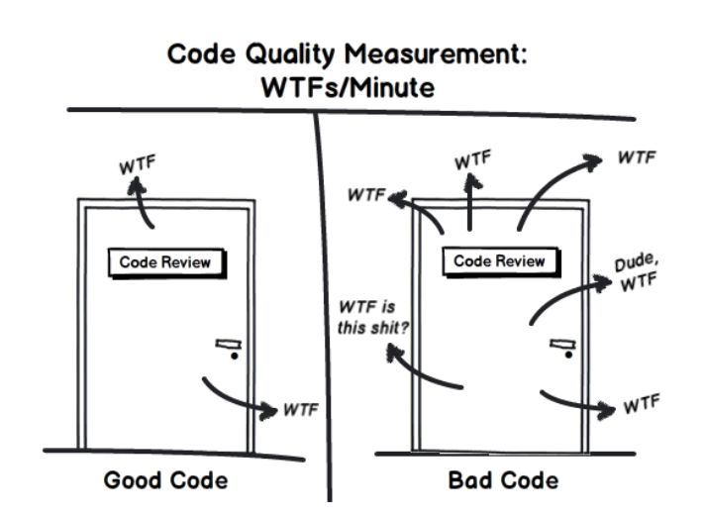
Code Quality Measurement:
Helps/Minute
Help
Help
Help
Help
Dude,
Help
Help what is this?
Help
Help

